Slide 1

Social Media Analytics
Sentiment and community detection about winter transfer market window on r/ACMilan
Andrea Lucini Paioni, 826578
Academic Year 2023/24

Slide 2



Introduction
Questa foto di Autore sconosciuto è concesso in licenza da CC BY-ND

Slide 3
Project goals
Collect data from r/ACMilan
Quickly analyze the data collected
Apply methods of sentiment analysis on both posts and comments, to analyze the general sentiment of the community during the winter transfer window.
Apply a method of topic modeling, to highlight the most common topics emerged with the posts
Apply community detection methods to analyze the composition of the subreddit.

Slide 4
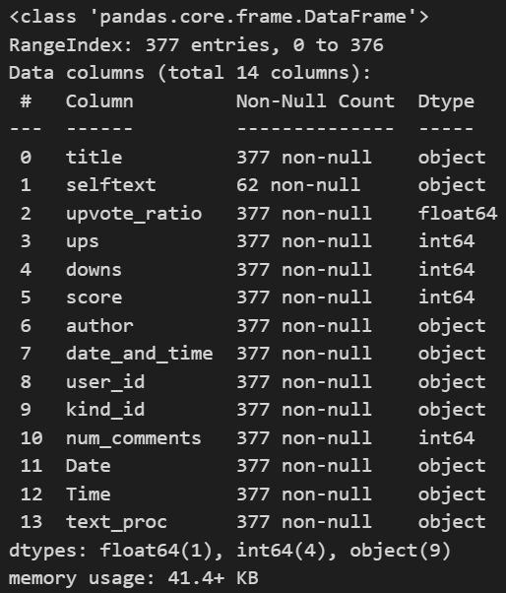

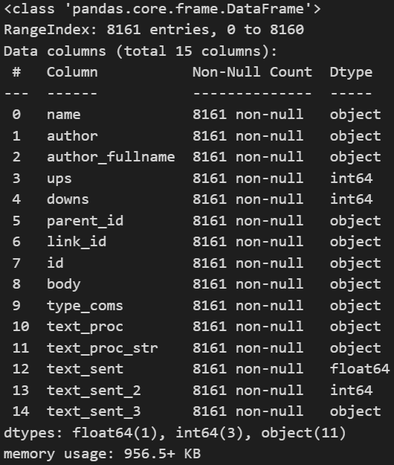
Data collection

Slide 5
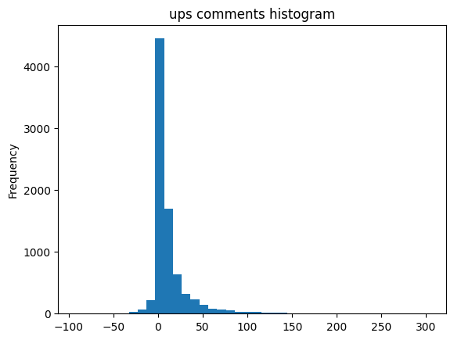
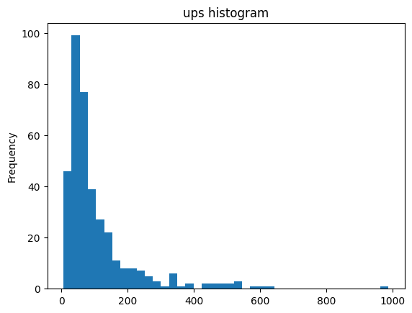
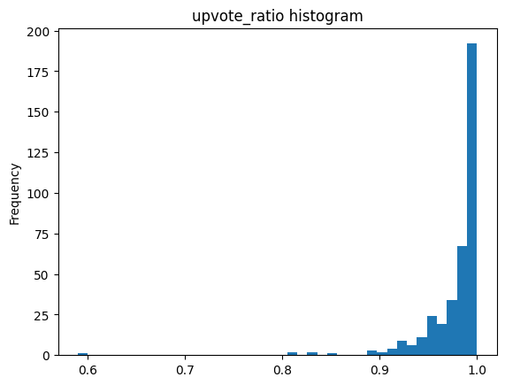
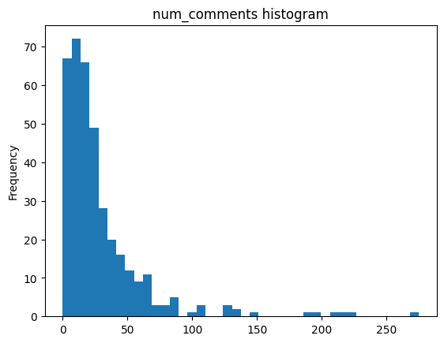
Exploratory Analysis

Slide 6
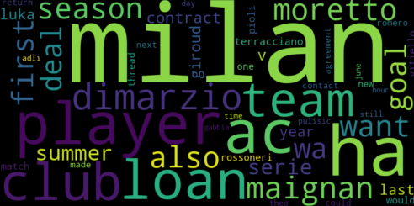
Topic modeling

Slide 7
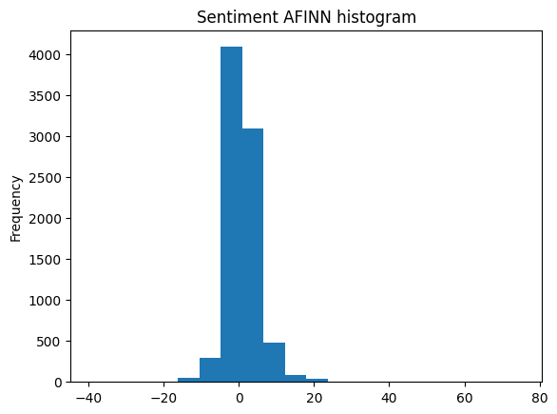
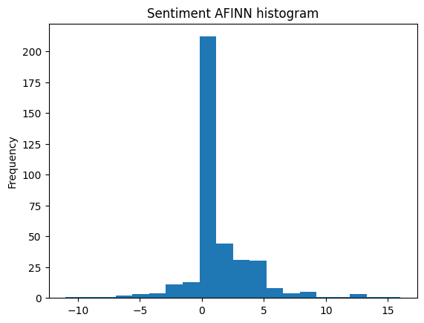
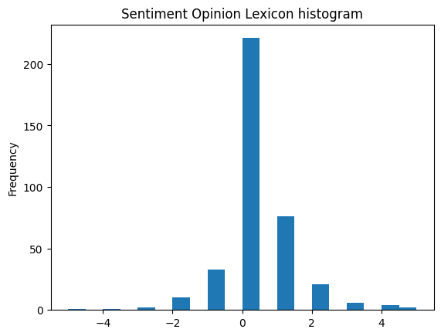
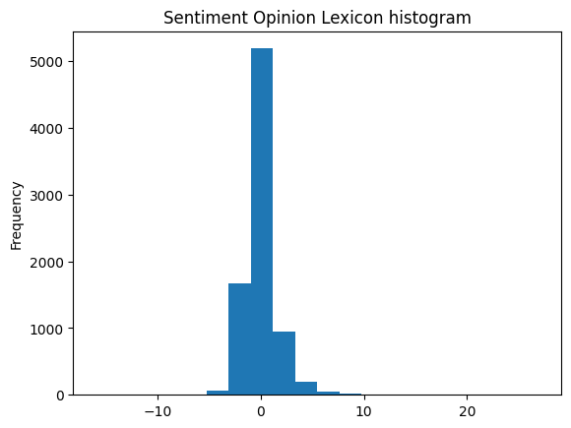
Sentiment Analysis

Slide 8
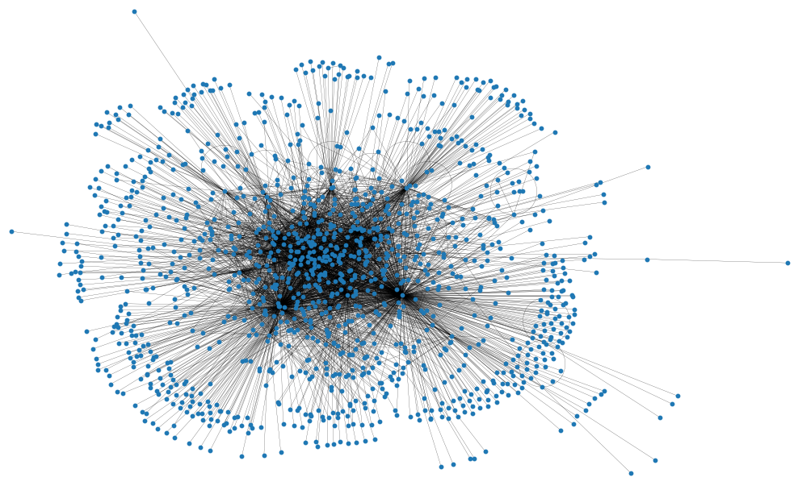
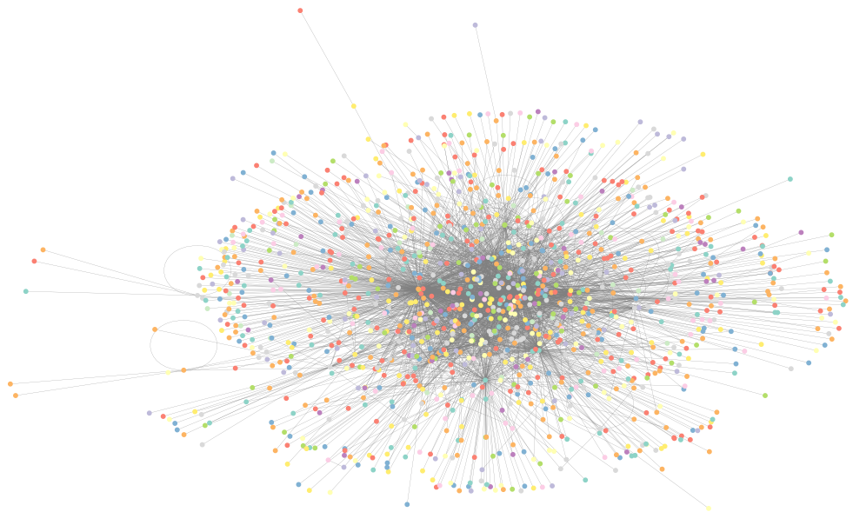
Community detection
1293 nodes, 3624 edges
Betweenness centrality top: Claija79(0.38), mercurialsaliva(0.34) and HeirOfRhoads(0.09).
Degree centrality top: Claija79(0.43), mercurialsaliva(0.39) and HeirOfRhoads(0.18).
Closeness centrality top: Claija79(0.61), mercurialsaliva(0.59) and HeirOfRhoads(0.51).
Diameter (6), radius (3), eccentricity (3-6).
Modularity: 0.35

Slide 9
Results and conclusions
Sentiment Analysis: three methods developed, overall positive sentiment, little distinctions between sentiment on posts and on comments.
Topic modeling: words related to Milan in general, and words related to Milan and the winter transfer market window.
Community detection: some of the most influent redditors found (Claija79, mercurialsaliva and HeirOfRhoads); communities on graph with mixed results.

Slide 10
Thanks for your attention!

